Slide 1
GROUP 1 INTEGRATED EXPERIENTIAL LEARNING Nearpeer Usage and Engagement to Predict Non-Enrollment

Slide 2
Contents
Executive Summary
Nearpeer Objectives
Business Problem
Exploratory Data Analysis
Key Questions
Findings and Recommendation
Future Research

Slide 3
Executive Summary
Out of all the variables, we chose to analyze 15 specific variables that we found most relevant and correlated to non-enrollment:
Enrolled at Census Y/N, Application Student Type, Hispanic Ethnicity Y/N, Orientation
attendance, Y/N, Race, Deposit Date, Residency, Major, Age, Interests, Interests Count, Number
of Peers, Open to Social Connections, Gender, Chats Total
Our hypothesis is that–
Null Hypothesis: There are no significant factors that predict non-enrollment among Nearpeer users.
Alternative Hypothesis: There are significant factors that predict non-enrollment among Nearpeer users.

Slide 4
Nearpeer Objectives
Help students feel connected from when they are admitted to a school. If they foster connections from the beginning not only to the university and professors but most importantly to their fellow students, they are more likely to enroll and stay enrolled for the entirety of the program. Nearpeer is a critical tool to help universities facilitate this connection.

Slide 5
Business Problem
The admissions process now provides most students with the same resources no matter if they are committed to enrollment or not planning on enrolling. How can the university determine whether a prospective student is not likely to enroll and how could the university make it more likely that, that type of student would enroll?

Slide 6
Exploratory Data Analysis
There were 1056 observations and 64 variables
We sorted through duplicate columns, and columns where there were many null values and landed on the 15 variables as the predictors we will be working with.

Slide 7
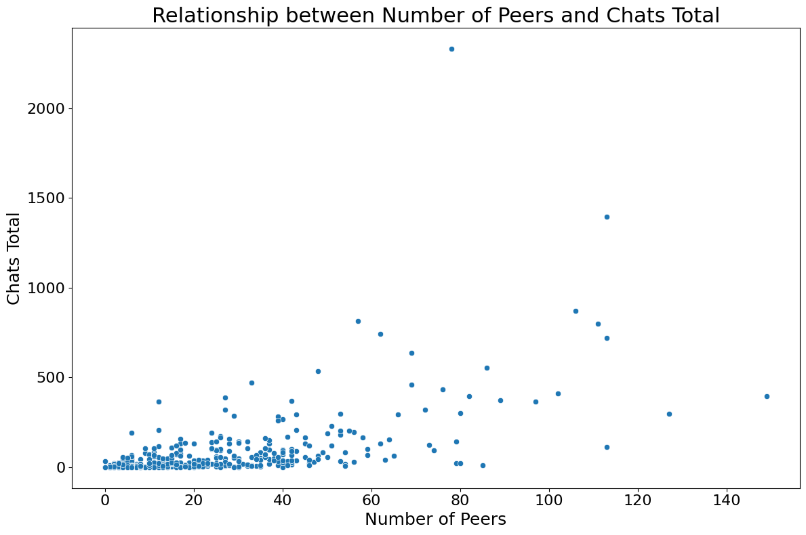
Relationship between Number of Peers and Chats
A Pearson correlation test resulted in
Correlation coefficient: 0.6239348198453031
P-value: 5.450989585433559e-109
The p-value is much less than the chosen significance level of 0.05. It suggests that the correlation is statistically significant and unlikely to be due to random chance.
The correlation coefficient indicates a moderate to strong positive linear relationship between the number of Peers and the total number of Chats.
This suggests that those who are using Nearpeer most are engaging in chats and making connections.

Slide 8
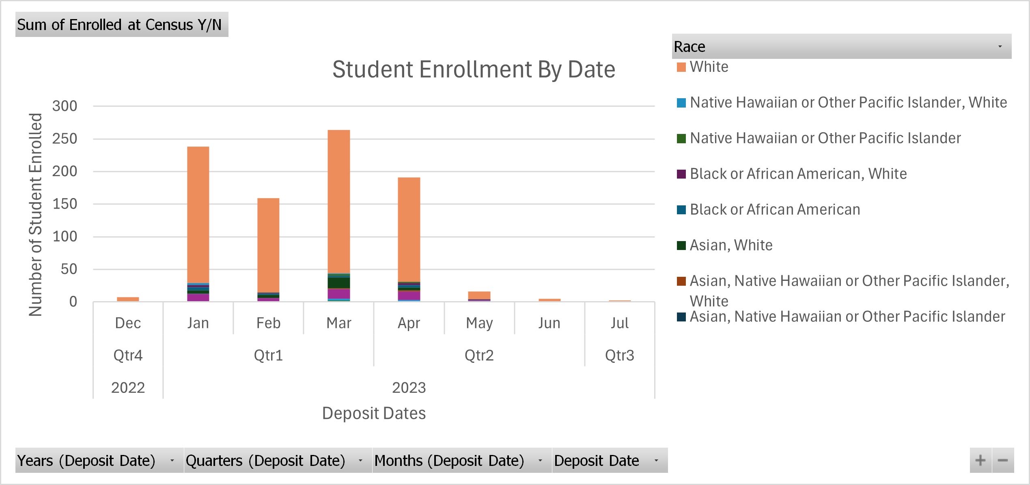
Relationship Between Deposit Dates and Major by Race
The chart reveals that the whites consistently have the highest counts across all time periods, particularly in January, March, and April.
Most activities are concentrated in Qtr1 of 2023, and then drops in counts during Qtr3 (July) and minimal activity in Qtr4 of 2022.
Other races have lower counts compared to the white category.
The chart suggests seasonal variations, with higher counts in the early quarters of 2023.

Slide 9
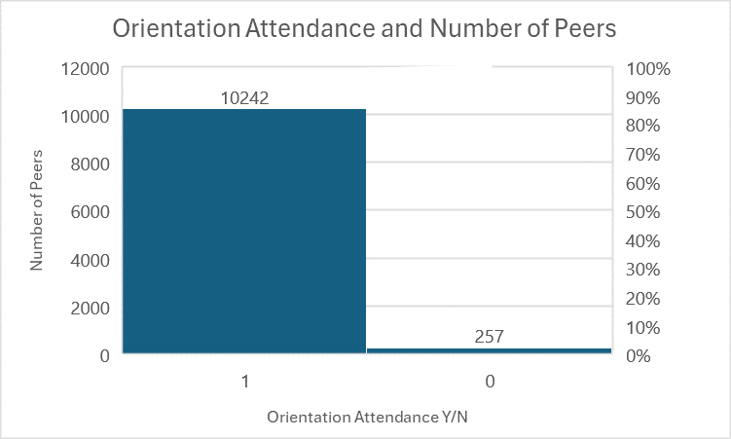
Relationship Between Orientation Attendance and Number of Peers
The chart indicates that individuals who attended the orientation tend to have a higher and more varied number of peers compared to those who did not attend.
This could imply that orientation attendance helps individuals build a larger network of peers, or that those who already have more peers are more likely to attend the orientation.

Slide 10
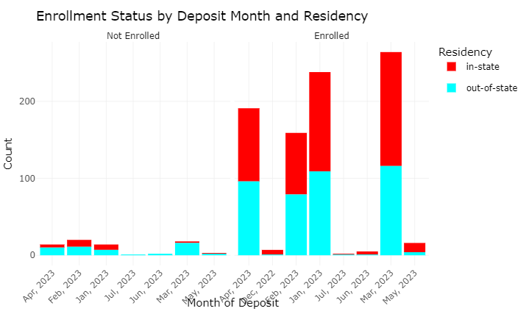
Enrollment status by Deposit Month and Residency
The chart displays monthly enrollment trends, revealing peaks in March and May for in-state students, and a significant peak in May for out-of-state students, underscoring key periods of student engagement.
It highlights more consistent enrollment for in-state students across various months, suggesting targeted outreach during lower activity months could enhance out-of-state student enrollment.
Interactive plot

Slide 11
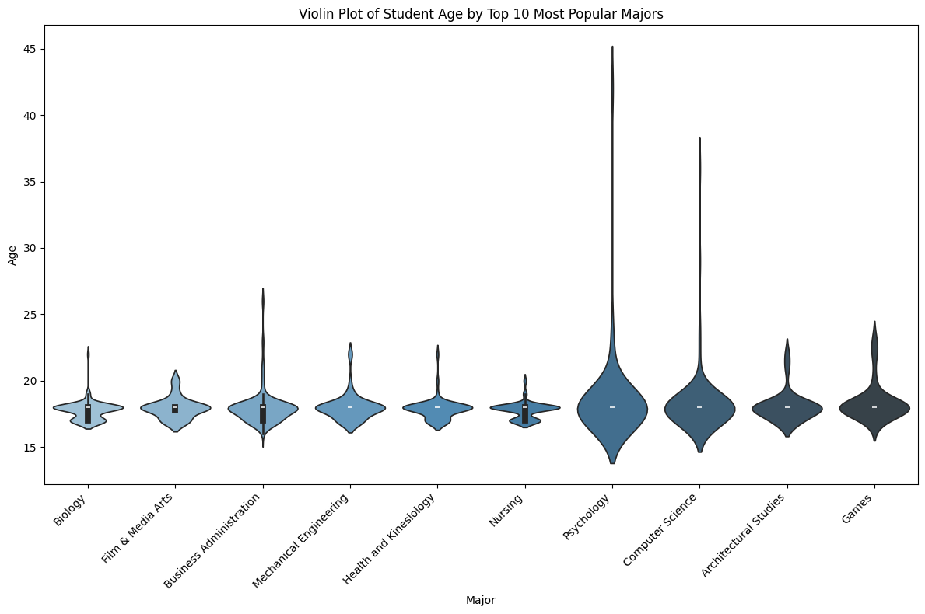
Major and Student Age
To understand the relationship between age and major this plot shows age density of the top 10 majors.
This shows some difference within age demographics of the most popular majors.
We chose10 because there were 90 unique majors to choose from.

Slide 12
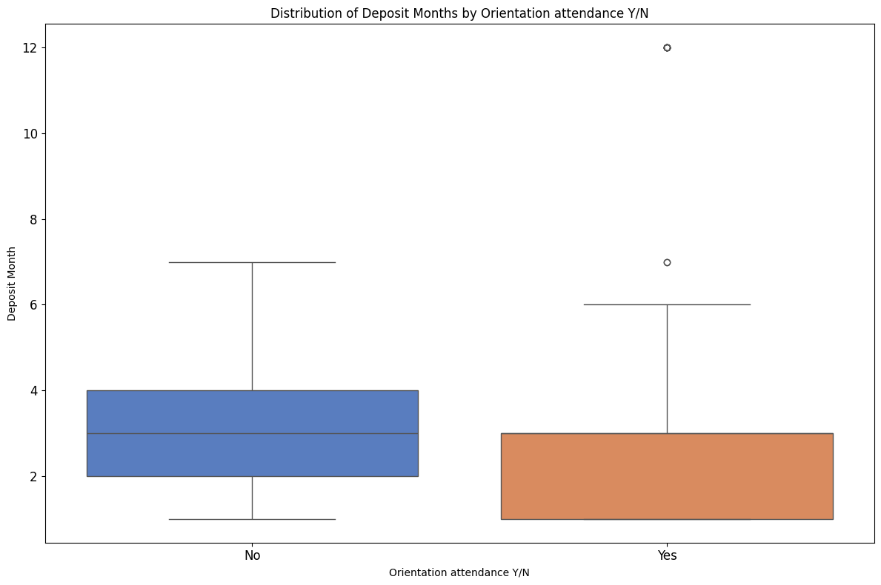
Significance Between Deposit Date and Orientation Attendance
A Mann-Whitney U test was performed to test the significance of the relationship.
Results:
Test Statistic: 20672.5
P-value: 0.1108133564922299
The p-value is greater than the target significance level of 0.05, suggesting that there is no statistically significant difference in the distribution of deposit months between students who attended orientation and those who did not.

Slide 13
Key Questions
How do Application Student Type, Orientation Attendance Y/N, and Number of Peers relate to Enrolled at Census Y/N? Does the data indicate that certain types of applicants, along with their orientation attendance and social connections, are more likely to complete the enrollment process?
How does the frequency of undecided (Major) students vary concerning their age and total chats, and how does this relate to their enrollment status?
Is there a particular month during which deposits are more strongly associated with enrollment?

Slide 14
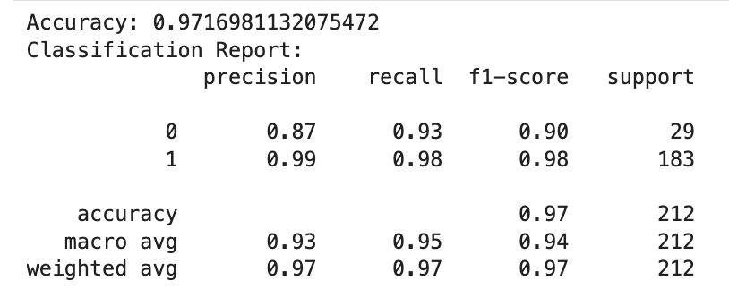
Data Split: Training set: 70% of dataset Testing set: 30% of dataset
Predictive Model - Random Forest Classifier
Objective: To predict Students who are likely to Enroll or not enroll
We built a Random forest classifier model using our chosen 15 variables (slide 3).
The classifier distinguishes between students who enroll (positive cases) and those who don't (negative cases). The accuracy of 97% indicates that the classifier makes accurate predictions for the majority of students.
Specifically, the precision of 99% for enrollment suggests that when the classifier predicts a student will enroll, it is highly likely to be correct.
This shows that it is more difficult to predict non-enrollment but that our model does a good job of doing so.

Slide 15
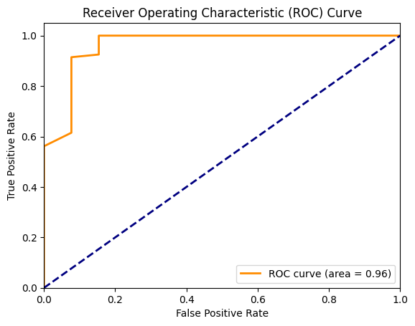
Model Performance
An AUC of 0.96 indicates that the model is performing extremely well, distinguishing between positive and negative classes with a high degree of accuracy.
This level of performance suggests that the model is reliable and effective for the task it was trained on.

Slide 16
Logistic Regression Model
Objective: To quantify the influence of various factors on student enrollment decisions.
The model has a strong fit with a Pseudo R-squared of 0.5093, explaining 51% of enrollment variability.
'Orientation attendance' and 'Age' are significant. Orientation increases enrollment likelihood, while age slightly decreases it.
'Interests Count,' 'Chats Total,' and 'Residency_out-of-state' are not significant, suggesting they don't strongly influence enrollment. Further analysis may be needed.
Optimization terminated successfully. Current function value: 0.131293 Iterations: 39 Function evaluations: 40 Gradient evaluations: 40 Logit Regression Results ================================================================================== Dep. Variable: Enrolled at Census Y/N No. Observations: 954 Model: Logit Df Residuals: 948 Method: MLE Df Model: 5 Date: Sat, 08 Jun 2024 Pseudo R-squ.: 0.5093 Time: 17:54:12 Log-Likelihood: -125.25 converged: True LL-Null: -255.26 Covariance Type: nonrobust LLR p-value: 3.904e-54 ============================================================================================== coef std err z P>|z| [0.025 0.975] ---------------------------------------------------------------------------------------------- const 3.3469 0.226 14.789 0.000 2.903 3.790 Age -0.2077 0.099 -2.093 0.036 -0.402 -0.013 Orientation attendance Y/N 1.3666 0.140 9.757 0.000 1.092 1.641 Interests Count 0.1451 0.265 0.548 0.584 -0.374 0.664 Chats Total 0.5409 0.620 0.872 0.383 -0.675 1.756 Residency_out-of-state -0.3487 0.199 -1.754 0.079 -0.738 0.041 ==============================================================================================

Slide 17
Findings
The Pearson correlation test showed that more active Nearpeer users engage in chats and connections.
Engagement is highest in the early parts of the year and drops off mid to late year.
Orientation attendance builds a higher peer network.
There are noticeable variations in age distributions across the top 10 most popular majors, highlighting diverse age demographics among these majors
In-state enrollment is more consistent.
There is no significant relationship between Orientation attendance and deposit dates.
Our Random forest classifier was good at predicting enrollment. It had an accuracy of 97% and AUC of 96%. However, it is unable to predict non-enrollment.
Logistic- Regression model: Orientation attendance increases enrollment likelihood, while age slightly decreases it, and factors like interests Count, Chats Total, and Residency (out-of-state) do not strongly influence enrollment.

Slide 18
Recommendations
Concentrate promotional efforts during the highest enrollment months by offering discounts, sharing student success stories, and implementing referral programs with incentives to boost engagement and attract more students
Run engagement programs in the middle of the school year to keep potential students interested. Some examples of this are online open houses, workshops about financial help, and one-on-one meetings with admissions counselors.

Slide 19
Future Research
We would like to further explore which variables of the ones we have chosen have the most sway on non-enrollment prediction.
We would like to understand why, if possible, it is more difficult to predict non-enrollment than enrollment.
Explore new strategies to maintain student engagement and interest during off-peak months when deposit activity is low.
Look into how combining Nearpeer with academic counseling can help students succeed and get more help.

Slide 20
References:
Hodeghatta, U. R., & Nayak, U. (2023). Practical Business Analytics Using R and Python: Solve Business Problems Using a Data-driven Approach. Apress.
Strayhorn, T. L. (2018). The sense of belonging among college students is a crucial factor that contributes to improved educational success for all students.
Yeager, D. S., Walton, G. M., Brady, S. T., Akcinar, E. N., Paunesku, D., Keane, L., ... & Dweck, C. S. (2016). Introducing a lay theory to students before college has the potential to significantly reduce achievement inequalities on a large scale.
Kuh, G. D., Kinzie, J., Schuh, J. H., and Whitt, E. J. (2011). Enhancing college student achievement: Establishing influential circumstances. John Wiley & Sons is a publishing company.

Slide 21

Individual Proposals

Slide 22
Individual Proposals
Enhancing Predictive Features for Personalized Support
Developing Meaningful Staff-Student Interactions
Student Engagement Through Interest-Based Groups on Nearpeer
The Effect of Parental Education in Predicting Enrollment and Student Retention
A Comprehensive Predictive Model for Early Identification of At-Risk Students Using Multidimensional Data Integration

